Slide 1
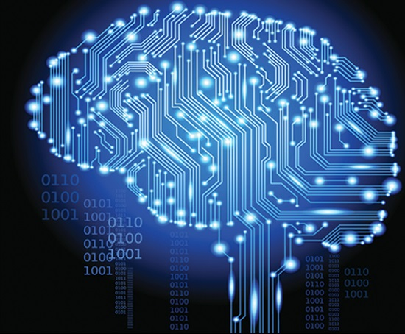
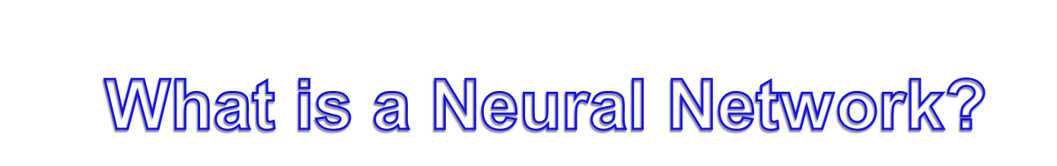
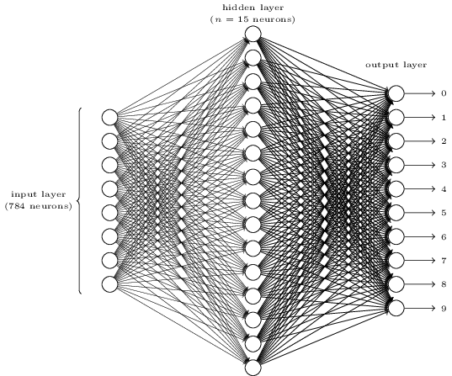
Password Prediction:
Predicting passwords with the use of a Neural Network
Presented on: April 4th at 6:00 p.m.
Abstract: Passwords are often used to control access to a users account. These passwords are stored in a hashed format. This project seeks to train a Neural Network on these hashed passwords to recover the original password. In order to train the Neural Network, I generated a training set of 752,000 hashed passwords. Then, I used it to predict the passwords for a test set of 3765 unique hashed passwords. The Neural Network recovered one password completely from the test data with others being off slightly.
An IRC by Andrew Buxa
A Neural Network is a system of hardware and/or software patterned after the operation of neurons in the human brain.
Implementation and Analysis:
The first step of training a Neural Network is to generate training data that it can learn from.
I start by generating a password of length n and generate all permutations of the password with all possible characters (that you can use in a password). Now, I split a small percentage of the data generated to use as training data.
Password Example: LZU
Then, I convert each character of the password into its hexadecimal value, then convert that into binary. In addition, I run the character password through a hashing function (MD5) to acquire the hex digest and convert that into binary:
acd6ea4ac9570f4901759200266580ad
Hexdigest: 10101100110101101110101001001010110010010101011100001111010010010000000101110101100100100000000000100110011001011000000010101101 (128 bits long)
Character Password:
010011000101101001010101 (24 bits long)
This is the basic overview of the Neural Network, where you have the input (left) which will be the hexDigest, the Hidden Layer (middle) which transforms input data into something the output layer can use. Finally, you have the output layer (right) which gives out a variation of the character password.
Finally, to start testing, all I need to do is enter in the binary hexdigest as input and it should (theoretically) predict the password or predict a password close to it, as you can see in the results.
Results:
Amount of passwords predicted with positions right (out of 3765 test data passwords):
24 positions right: 1
23 positions right: 1
22 positions right : 0
21 positions right: 4
20 positions right : 25
19 positions right : 63
18 positions right : 157
17 positions right : 279
16 positions right : 460
15 positions right : 676
14 positions right : 662
Now, instead of having to brute force 16,777,216 passwords (2^24), the Neural Network has cut the amount of work needed to brute force a password significantly. I now only need to make x amount of changes to the passwords (which don’t have 24 positions right), where x is 2^24-positions right. For example: 2^24-21 = 8 possible combinations to get the right password.
References:
1. http://www.faqs.org/rfcs/rfc1321.html (MD5 hashing function explanation)
2. http://pybrain.org/docs/ (Neural Network library)

